Slide 1
Chapter 13
Support Vector Machines
Optimization objective
And compared to both the logistic regression and neural networks, the support Vector Machine or the SVM, sometimes gives a cleaner and sometimes more powerful way of learning complex nonlinear functions.

Slide 2
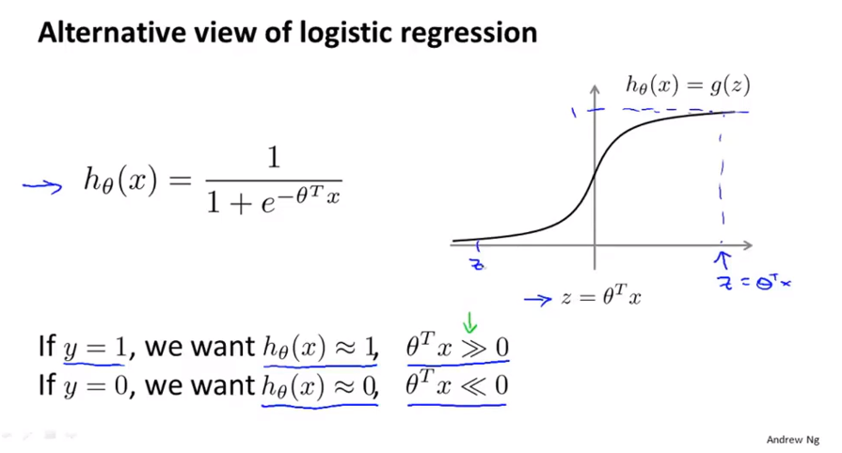
Chapter 13

Slide 3
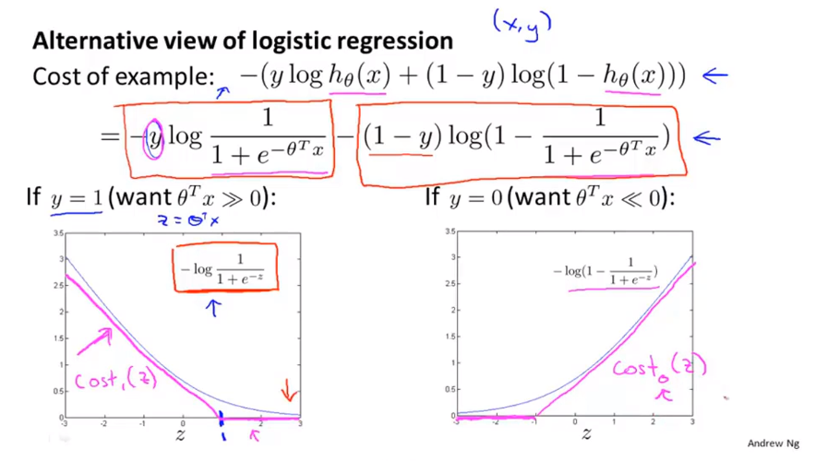
Chapter 13
When z is equal to large that is when theta transpose x is large that corresponds to a value of z that gives us a very small value, a very small contribution to the cost function.

Slide 4
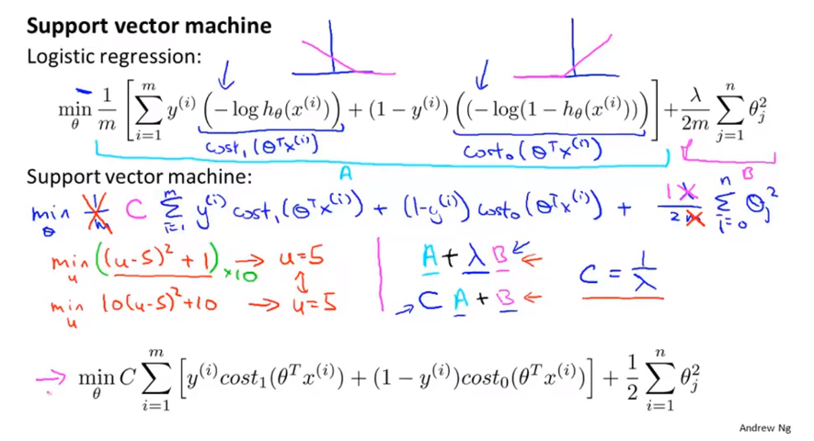
Chapter 13

Slide 5
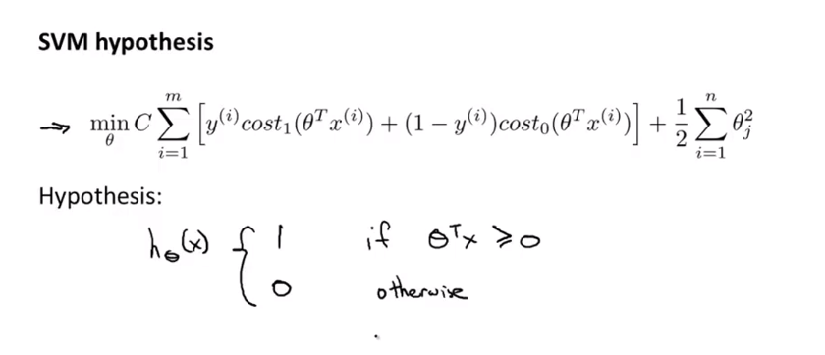
Chapter 13

Slide 6
Chapter 13
Support Vector Machines
Large Margin Intuition
Sometimes we talk about support vector machines as large margin classifiers.

Slide 7
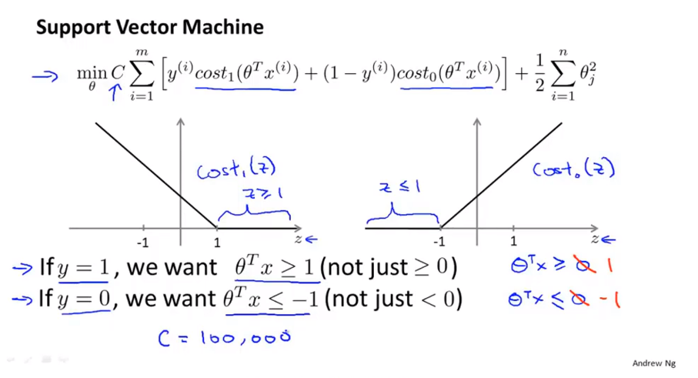
Chapter 13
And so this build in an extra safety factor or safety margin factor into the support vector machine.
Logistic regression does something similar too of course.

Slide 8
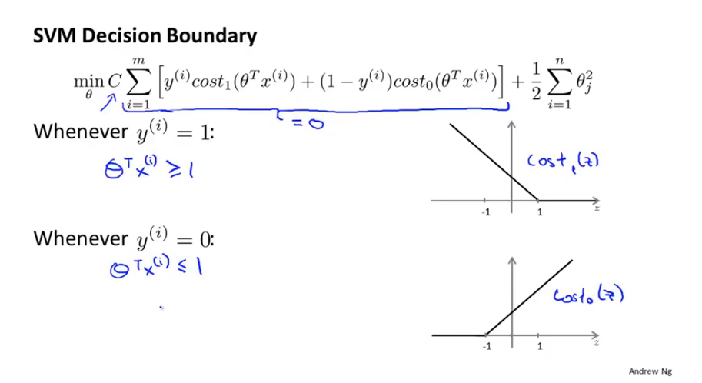
Chapter 13

Slide 9
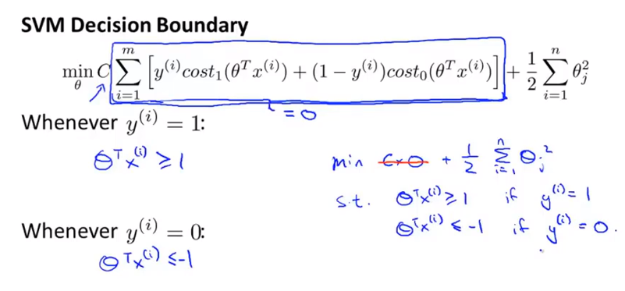
Chapter 13

Slide 10
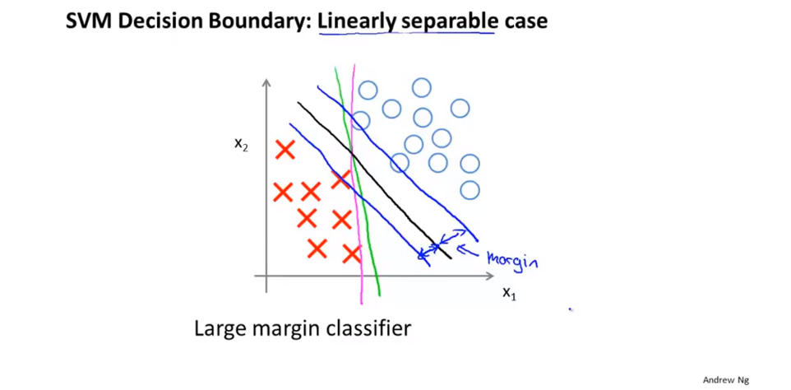
Chapter 13
This gives the SVM a certain robustness because it tries to separate the data with as large a margin as possible.

Slide 11
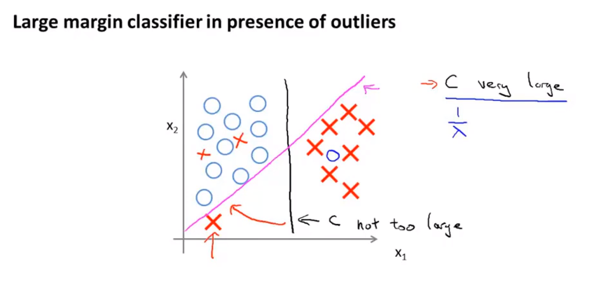
Chapter 13
If all you’re doing is use a large margin classifier then your learning algorithms can be sensitives to outliers.
If the data were not linearly separable so if you had some positive examples in here, or you have some negative examples in here then the SVM will also do the right thing.
When applying support vector machines, when C is not very very large like that it can do a better job ignoring the few outliers like here. And also do fine and do reasonable things even if your data is not linearly separable.

Slide 12
Chapter 13
Support Vector Machines
The mathematics behind large margin classification(optional)

Slide 13
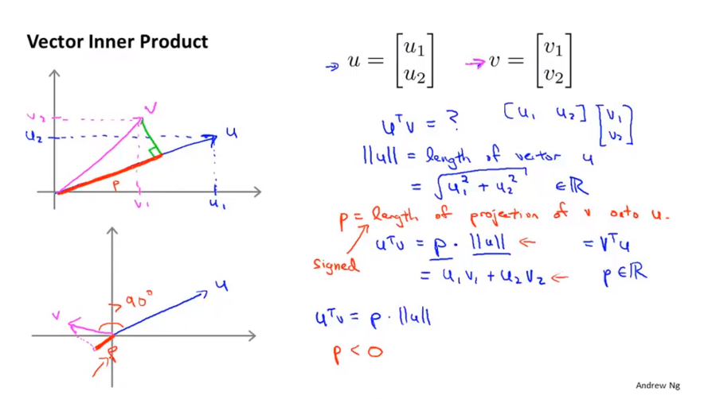
Chapter 13

Slide 14
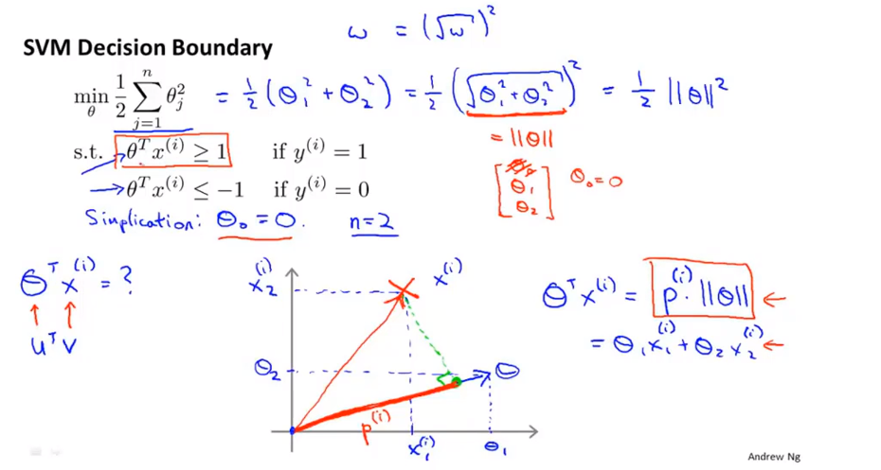
Chapter 13
All the support vector machine is doing in the optimization objective is it’s minimizing the square norm of the square length of the parameter vector theta.

Slide 15
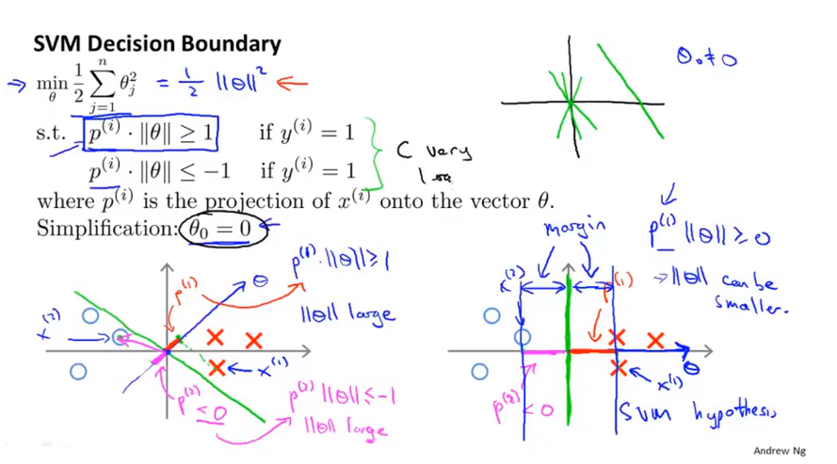
Chapter 13
And so by making the margin large, by making these tyros P1,P2,P3 and so on that the SVM can end up with a smaller value for the norm of theta which is what is trying to do in the objective. And this is why this support vector machine ends up with enlarge margin classifiers, because it is trying to maximize the norm of these P1 which is the distance from training examples to the decision boundary.

Slide 16
Chapter 13
Support Vector Machines
Kernels Ⅰ

Slide 17
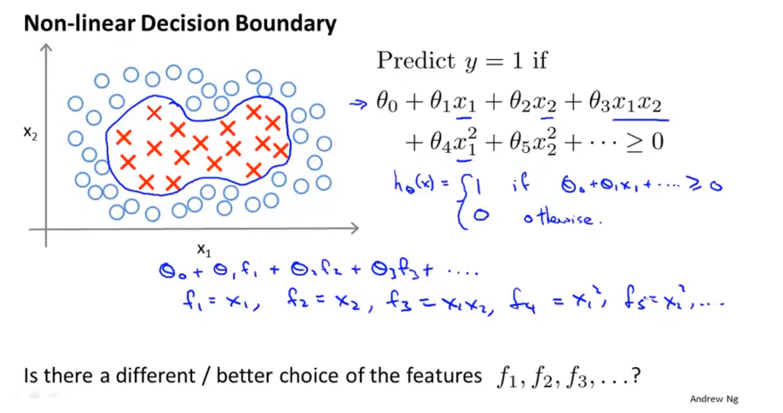
Chapter 13

Slide 18
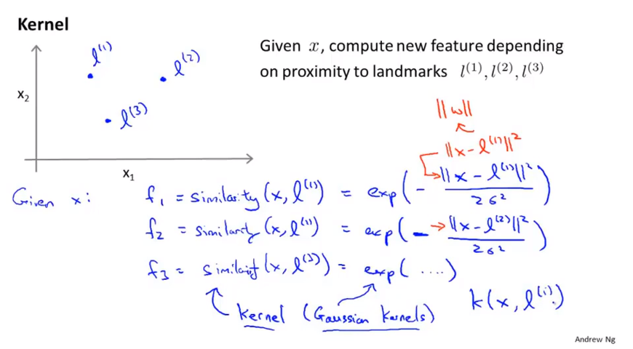
Chapter 13
And the specific kernel I’m using here this is actually called a Gaussian kernel. And so this formula, this particular choice of similarity function is called a Gaussian kernel.
In the abstract these different similarity functions are called kernels and we can have different similarity functions and specific example I’m giving here is called Gaussian kernel.

Slide 19
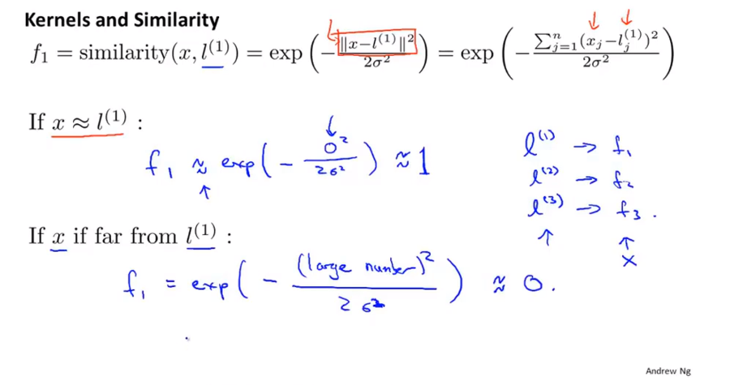
Chapter 13
Ignoring the intercept term(截距项) X0 which is always equal to 1. the Euclidean distance.
is
Exponentiation function / similarity function

Slide 20
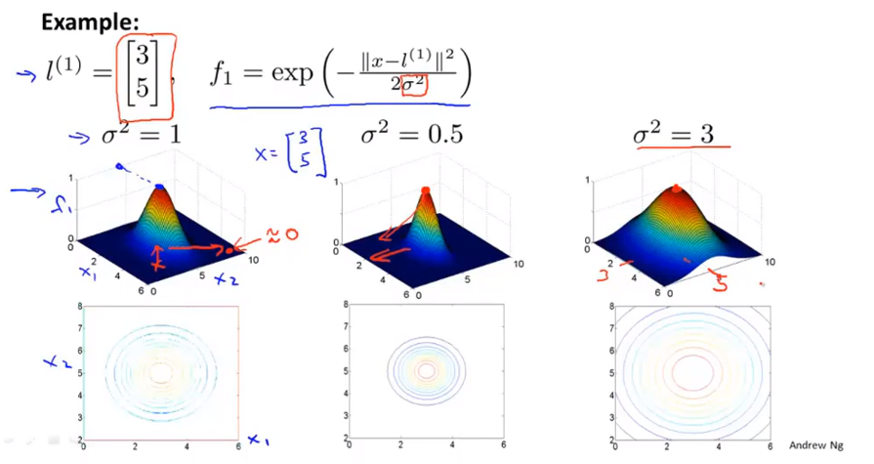
Chapter 13
If sigma to 2 is large, then as you move away from l1, the value of the feature fall away much more slowly.

Slide 21
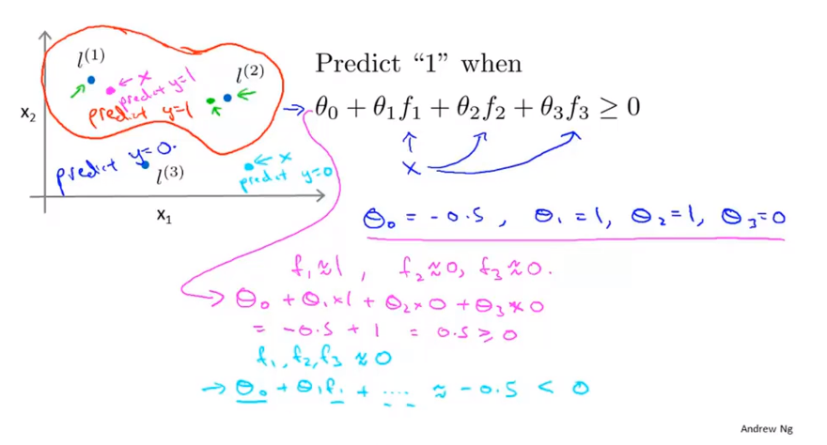
Chapter 13
And so this is how with this definition of the landmarks and of the kernel function. We can learn pretty complex non-linear decision boundary, like what I just draw where we predict positive when we’re close to either one of the two landmarks. And we predict negative when we’re very far away from any of the landmarks.

Slide 22
Chapter 13
This is part of the idea of kernels of and how we use them with the support vector machine, which is that we define these extra features using landmarks and similarity functions to learn more complex nonlinear classifiers.

Slide 23
Chapter 13
Support Vector Machines
Kernels Ⅱ

Slide 24
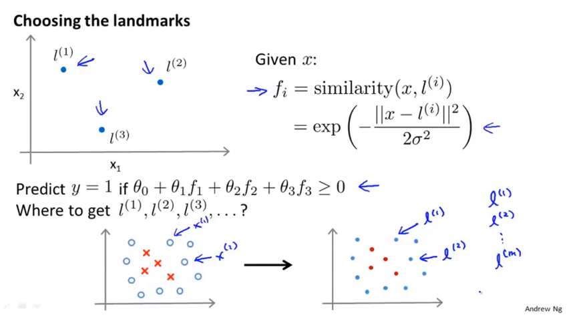
Chapter 13
And this is nice because it is saying that my features are basically going to measure how close an example is to one of the things I saw in my training set.

Slide 25
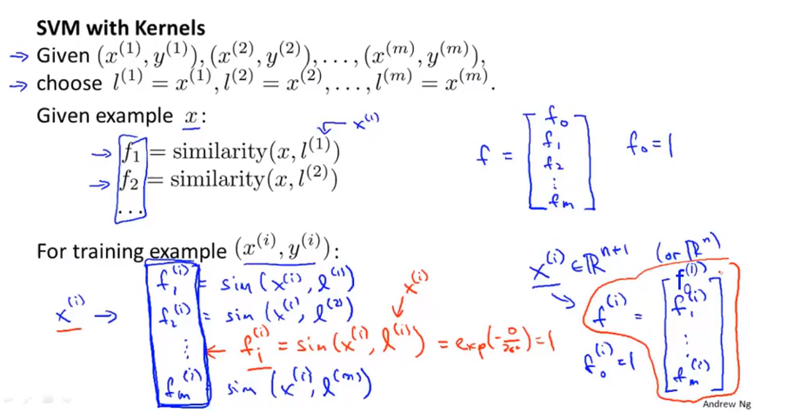
Chapter 13

Slide 26
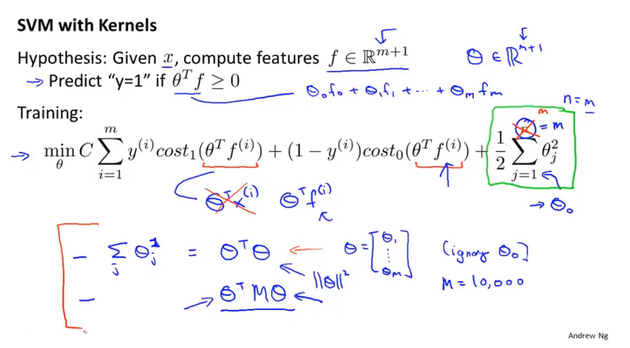
Chapter 13
How to make prediction if you already have a setting for the parameter’s theta.
It actually modifies that last term a little bit to optimize something slightly different than just minimizing the norm squared of theta squared, of theta. Bit is done primarily for reasons of computational efficiency.

Slide 27
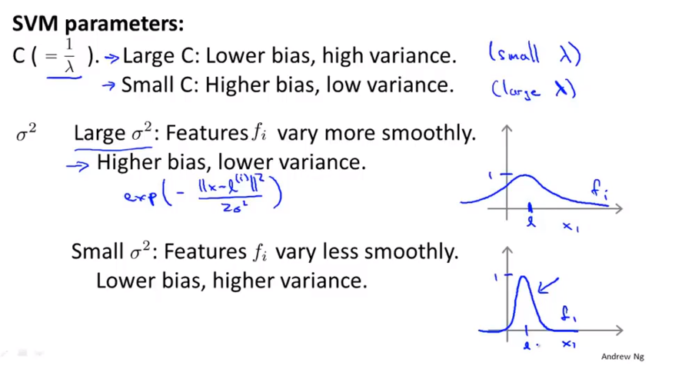
Chapter 13

Slide 28
Chapter 13
Support Vector Machines
Using an SVM

Slide 29
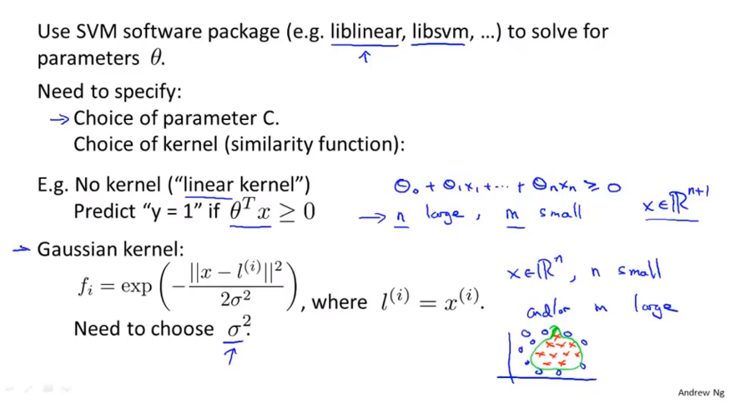
Chapter 13
If sigma squared is large, then you tend to have a higher bias lower variance classifier, but if sigma squared is small, then you have a higher variance, lower bias classifier.

Slide 30
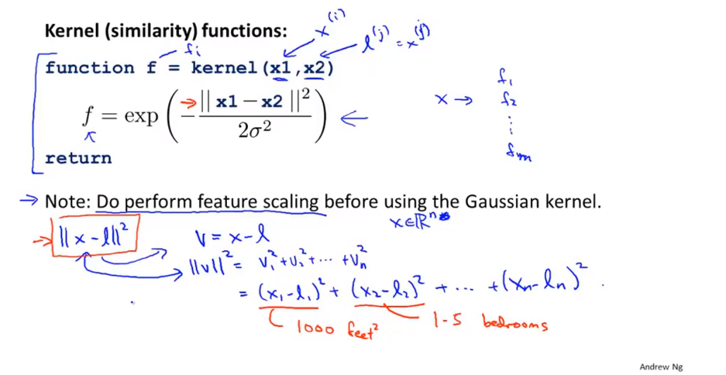
Chapter 13

Slide 31
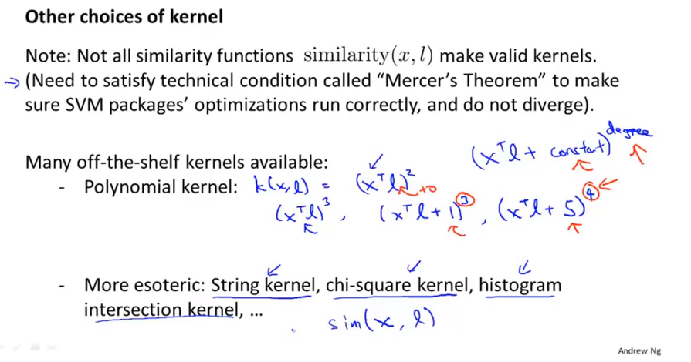
Chapter 13
Usually it used for data where X and I are all strictly non negative.
So it ensures that inner products are never negative. And this captures the intuition that X and I are very similar to each other, then maybe the inner product between them will be large.
If you do a quick web search, you should have found definitions that these are the kernels as well.

Slide 32
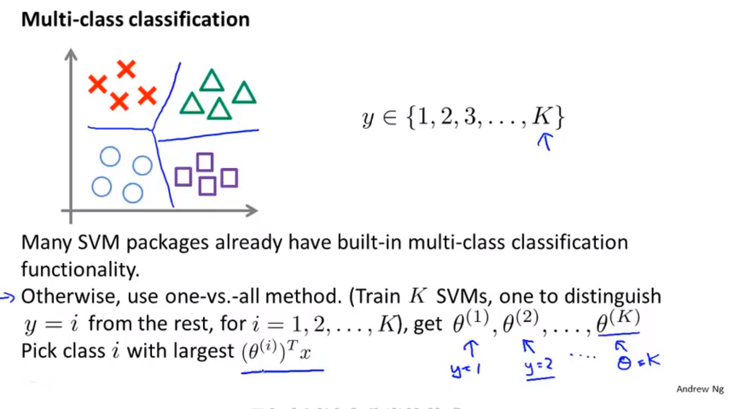
Chapter 13
y

Slide 33
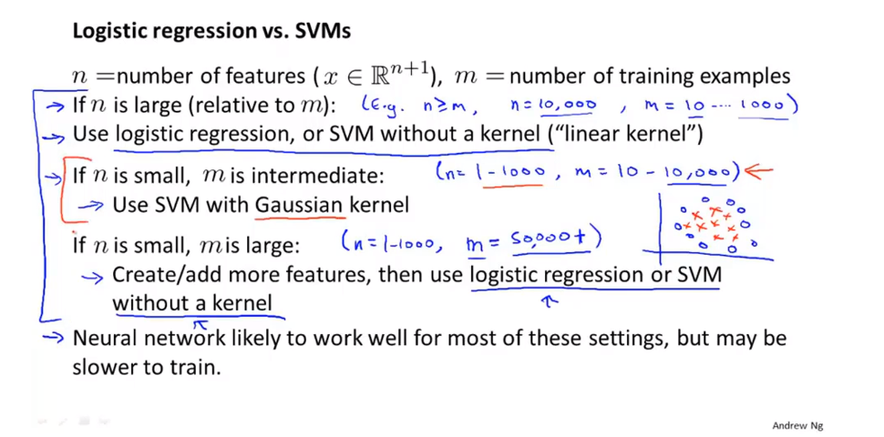
Chapter 13
Logistic regression and SVM without the kernel those are really pretty similar algorithms and, either LC or SVM without a K will usually do pretty similar thing and give pretty similar performance but depend on your implementation details one maybe more efficient than the other. But where one of these algorithm applies, logistic regression where SVM without a kernel the other one is to likely to work pretty well as well.

Slide 34
Chapter 13
And this regime, when you have maybe up to 10,000 examples, maybe up to 50,000 and your number of features, this is reasonably large. That’s a very common regime and maybe that’s a regime where support vector machine without a kernel will shine, and you can do things much harder to do that with logistic regression.
For all these problem, for all of these different regimes, a well designed neural network is likely to work well as well. The one disadvantage, or the one reason that might not sometimes use the neural network is that, for some of this problems, the neural network might be slow to train. But if you have a very good SVM implementation package, that could run faster, quite a bit faster than your neural network.
The optimization problem that the SVM has is a convex optimization problem and so the good SVM optimization software packages will always find the global minimum or something close to it.
And so for SVM, you don’t need to worry about local optima.
In practice, local optima aren’t a huge problem for neural network, but they all solve, so this is one less thing to worry about if you’re using an SVM. And depending on your problem, the neural network maybe slower, especially in this sort of regime than the SVM.
SVM is still widely perceived as one of the most powerful learning algorithm, and this is regime of when there’s a very effective way to learn complex non linear functions.

